Slide 1
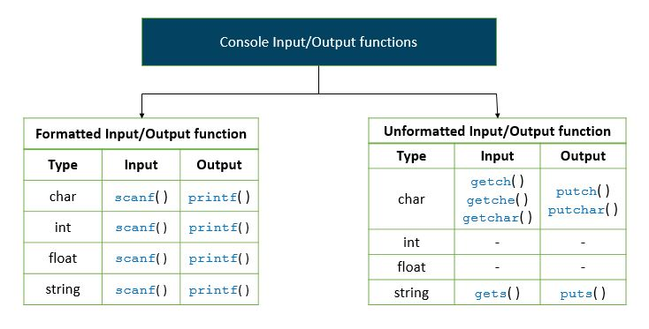

Slide 2
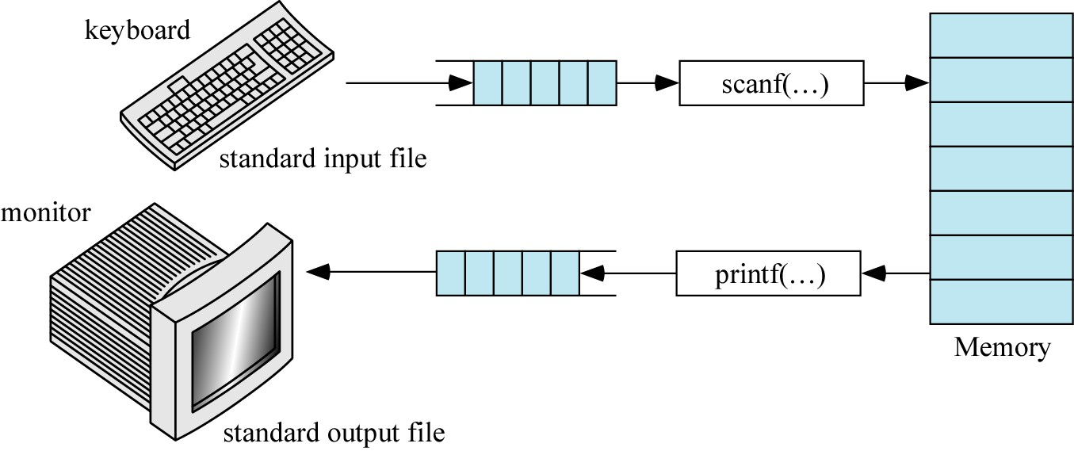
INPUT and OUTPUT
(stdin)
(stdout)

Slide 3
Basic Output function
Printf function
sends output to standard output device,
usually a video monitor
printf("format string", output-list);
where ”format string” can contain characters to be output and the conversion specifiers indicating type and position of the output values. For output, we specify formats conversion specifiers) a little differently than we do for input. For example:
%i, | %d | -decimal integer
%o |  | -octal integer
%x, | %X | -hex integer (use X for caps A - F)
%f |  | -float, double
%c
%s
-character
-character string
www.cyberlabzone.com

Slide 4
Output Control: Special characters
Each is represented by an escape sequence, which is a backslash (\) and an escape character. Examples are:
\" | - | output double quotes
\b | – | backspace
\? | - | output question-mark character | (?)
\\ | - | output backslash character (\)
\n | - | new line
www.cyberlabzone.com

Slide 5
Output Control: Field Width
The number of print positions to be used in the output of display values. For floating-point numbers, we can also specify the number of digits to be displayed after the decimal point.
Examples:
%3d - display an integer using 3 print positions.
%7.3f - display a floating-point number (float, or double) using a total field width of 7 and with 3 places after the decimal point.
www.cyberlabzone.com

Slide 6
Printing Output: printf()
printf() will print formatted output to the screen.
To print a message:
printf("This is a message\n");
this is a string literal
How do we print the value of a variable?
Answer: Use special format specifiers depending on the type of
the variable

Slide 7
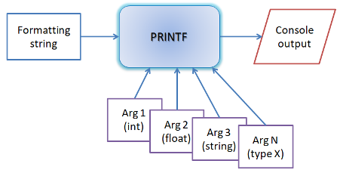
printf() working principles
printf or print function in C takes a formatting string and couple of optional variables as input and outputs strings to console while converting input variables to strings.
Printf and scanf takes multiple arguments and these functions are called variable length arguments function or vararg function.
Take printf for consideration. User supply a string and input argumnets. Printf creates an internal buffer for constructing output string. Now printf iterates through each characters of user string and copies the character to the output string.
Printf only stops at "%". "%" means there is an argument to convert. Arguments are in the form of char, int, long, float, double or string. It converts it to string and appends to output buffer. If the argument is string then it does a string copy. Finally printf may reach at the end of user sting and it copies the entire buffer to the stdout file.
Format Specifiers
White Spaces
Character to be printed

Slide 8
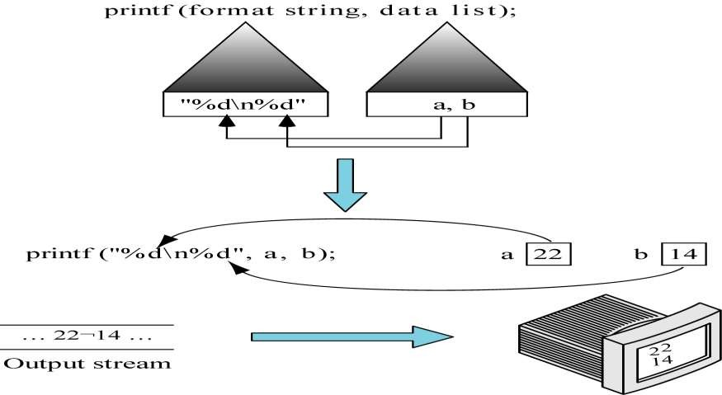

Slide 9
int degreesF = 68;
printf("The temperature is %d degrees.", degreesF);
Specifier for
“print an integer value”
“and the value of that number is read from this variable”
Output:
> The temperature is 68 degrees.

Slide 10
printf(“%d plus %d is equal to %d", a, b, c);
int | a | = | 1;
int | b | = | 2;
int | c | = | 3;
Output:
1 plus 2 is equal to 3

Slide 11
C Printf() Function
The printf function in C++ is used to write the output that is formatted to stdout.
Function Prototype:
int printf (const char* format, …);
Parameters:
format => A pointer to null-terminated string written to file stream. It consists of characters along with an optional format specifier that begins with %. The format specifier is replaced by appropriate values that follow the format string.
… => Other additional arguments that specify the data to be printed in the order the format is specified.
Return value:
Success => printf returns the number of characters returned.
Failure => Negative value
Description:
The printf function is defined in <cstdio> header.
The printf functions write the string pointed to by the “format” pointer to standard output stdout.
The format string may contain format specifiers which are then replaced by the variables passed to the printf function as additional arguments (after format string).

Slide 12
Format Specifier Used In printf () Function
A general form of format specifier is
%[flags][width][.precision][length]specifier
Given below is a description of each of the parts of format specifier:
% sign: This is a leading % sign
Flags: They can have the following values:
–: Left justifies the result within the field. By default, right justified.
+: The sign of the result attached to the beginning of the value including positive results.
Space: In the absence of a sign, space is attached to the beginning of the result.
#: Specify an alternative form of conversion.
0: Used for integer and floating-point numbers. Act as leading zeros in the absence of space.
Width: Specifies minimum field width in the form of a * or an integer value. This is optional.
Precision: Specifies precision with a ‘.’ followed by a * or an integer or nothing. This is also optional.
Length: The optional argument that specified the size of the argument.
Specifier: This is a conversion format specifier.

Slide 13
Various Format Specifiers used in C++ are as follows:
No Specifier Description
1 % Prints a %.
2 c Prints single character.
3 s Prints a string.
4 d/i Converts signed integer to decimal representation.
5 o Converts unsigned integer to octal representation.
6 x/X Converts unsigned integer to hexadecimal representation.
7 u Converts unsigned integer to decimal representation.
8 f/F Converts floating-point number to decimal representation.
9 e/E Converts floating-point number to decimal exponent notation.
10 a/A Converts floating-point number to a hexadecimal exponent.
11 g/G Converts floating-point number to decimal or decimal exponent notation.
12 n Number of characters written so far by this function call.
13 p A pointer pointing to Implementation defined character sequence.

Slide 14
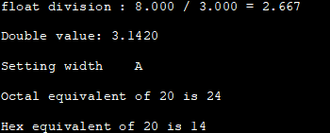
C printf Example
#include <cstdio> //C++ printf example int main() { char ch = 'A'; float a = 8.0, b = 3.0; double d = 3.142; int x = 20; printf("float division : %.3f / %.3f = %.3f \n", a,b,a/b); printf("Double value: %.4f \n", d); printf("Setting width %*c \n",4,ch); printf("Octal equivalent of %d is %o \n",x,x); printf("Hex equivalent of %d is %x \n",x,x); return 0; }
Output:

Slide 15
C Sprintf
Sprintf function in C++ similar to printf function except with one difference.
Instead of writing the output to standard output stdout, sprintf writes the output to a character string buffer.
Function Prototype:
int sprintf (char* buffer, const char* format, …)
Parameters:
buffer => Pointer to a string buffer to which the result is to be written.
Format=> Pointer to a null-terminated string that is written to file stream.
Note: The format string used in the sprintf function is the same as the one discussed as part of the printf function description.
… => Other additional arguments that specify the data to be printed in the order the format is specified.
Return Value:
success => Returns the number of characters written to the sufficiently large buffer excluding the terminating null character.
Failure => Negative value is returned.
Description:
Sprintf function is defined in the <cstdio> header.
The sprintf function is used to write a string pointed by the format to the string buffer.
The string format may contain format specifiers starting with % which are replaced by the values of variables that are passed to the sprintf () function as additional arguments.

Slide 16
sprintf Example
#include <cstdio>
#include <iostream>
using namespace std;
int main()
{
char mybuf[100];
int retVal;
char name[] = "Software Testing Help";
char topic[] = "C++ tutorials";
retVal = sprintf(mybuf, "Hi, this is %s and you are reading %s !!", name, topic);
cout << mybuf << endl;
cout << "Number of characters written = " << retVal << endl;
return 0;
}
Output:

Slide 17
Expression Statements
One form of a expression statement in C :
function(argument list) ;
One example is Scanf function accepts input from standard input device, usually a keyboard
scanf("format string", &var1, &var2, ...);
where “format string” is the string of conversion
specifiers for the various data types in the variable list.
%i. %d
%f
%lf
%Lf
%c
decimal integer (d=decimal)
float
double(where lf="long float")
long double
character
The number of conversion specifiers should match the
number of variables that follow the “format string”.

Slide 18
Keyboard input: scanf()
scanf() will scan formatted input from the keyboard.
It uses the same format specifiers as printf()
To read an integer:
int num_students;
scanf("%d", &num_students);
Specifier for
“reading an integer value”
VERY IMPORTANT
special symbol
“Place value into this
variable”

Slide 19
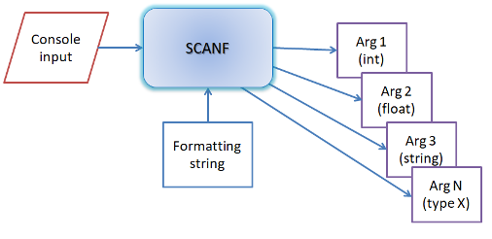
Scanf() working principles
scanf or scan function in C takes a formatting string as input and couple of optional variables as output reference arguments. It converts the scanned string to variables and copies to the output variables.
Format Specifiers
White Spaces
Character expected as input
Scanf is reverse process of printf. Scanf reads console input string.
It iterates each characters of user provided string and stops at "%".
Now scanf reads a line from stdin. User's input comes as a string.
It converts string to char, int, long, float, double and sets the value of the pointer located at the argument.
In care of string it simply copies the string to the output

Slide 20
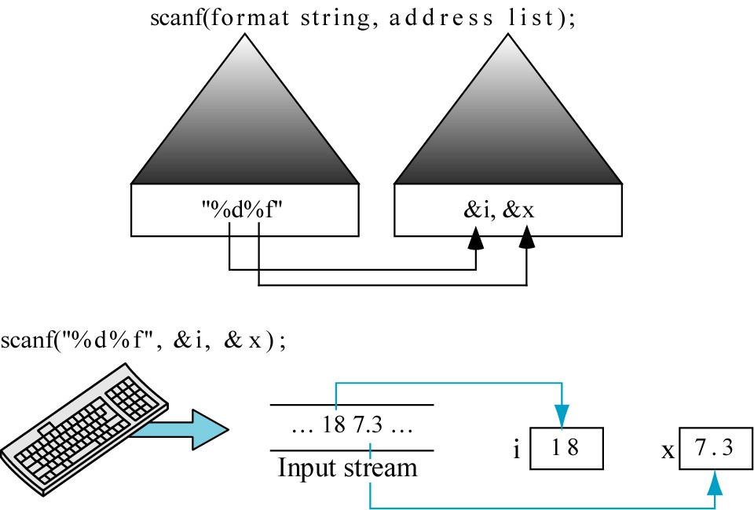

Slide 21
C Scanf
The scanf function in C++ reads the input data from standard input stdin.
Function Prototype:
int scanf (const char* format, …)
Parameters:
format => Pointer to a null-terminated string that defines how to read the input. This format string consists of format specifiers.
… => Additional arguments receiving data input. These additional arguments are in sequence according to the format specifier.
Return value:
success=> Returns a number of characters read in.
matchingFailure=> Returns zero if matching failure occurs before the first receiving argument is assigned.
input Failure => Returns EOF if an input failure occurs before the first receiving argument is assigned.
Description:
Scanf() function is defined in the <cstdio> header. This function reads the data from stdin and stores in the variables provided.

Slide 22
Format Specifier Used In scanf() Function
The general format for the scanf () function format string is:
%[*][width][length]specifier
Thus the format specifier has the following parts:
Non-whitespace character: These are the characters except % that consume one identical character from the input stream.
Whitespace character: All consecutive whitespace characters are considered as one whitespace character. The same goes for escape sequences too.
Conversion specification: It has the following format:
%: Character that specifies the beginning.
*: Called assignment suppressing character. If present, the scanf does not assign the result to any receiving parameters. This parameter is optional.
Field width: Optional parameter (a positive integer) that specifies a maximum field width.
Length: Specifies the size of receiving an argument.

Slide 23
Conversion Format Specifier used in scanf can be as follows:
No Format specifier Description
1 % Matches literal %.
2 c Matches single character or multiple characters up to width.
3 s Matches sequence of non-whitespace character until specified width or first whitespace.
4 d Matches decimal.
5 i Matches integer.
6 o Matches unsigned octal integer.
7 x/X Matches unsigned hexadecimal integer.
8 u Matches unsigned decimal integer.
9 a/A, e/E,f/F, g/G Matches floating-point number.
10 [set] Matches non-.empty sequence of characters from the given set. If preceded by ^, then characters not in set are matched.
12 n Returns number of characters read so far.
13 p Pointer to implementation specific character sequence.

Slide 24
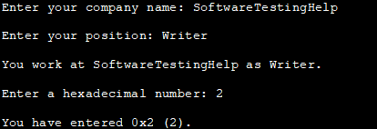
scanf Example
#include <cstdio>
int main ()
{
char str [80], pos_str[80];
int i;
printf ("Enter your company name: ");
scanf ("%79s",str);
printf ("Enter your position: ");
scanf ("%s",pos_str);
printf ("You work at %s as %s.\n",str,pos_str);
printf ("Enter a hexadecimal number: ");
scanf ("%x",&i);
printf ("You have entered %#x (%d).\n",i,i);
return 0;
}
Output:

Slide 25
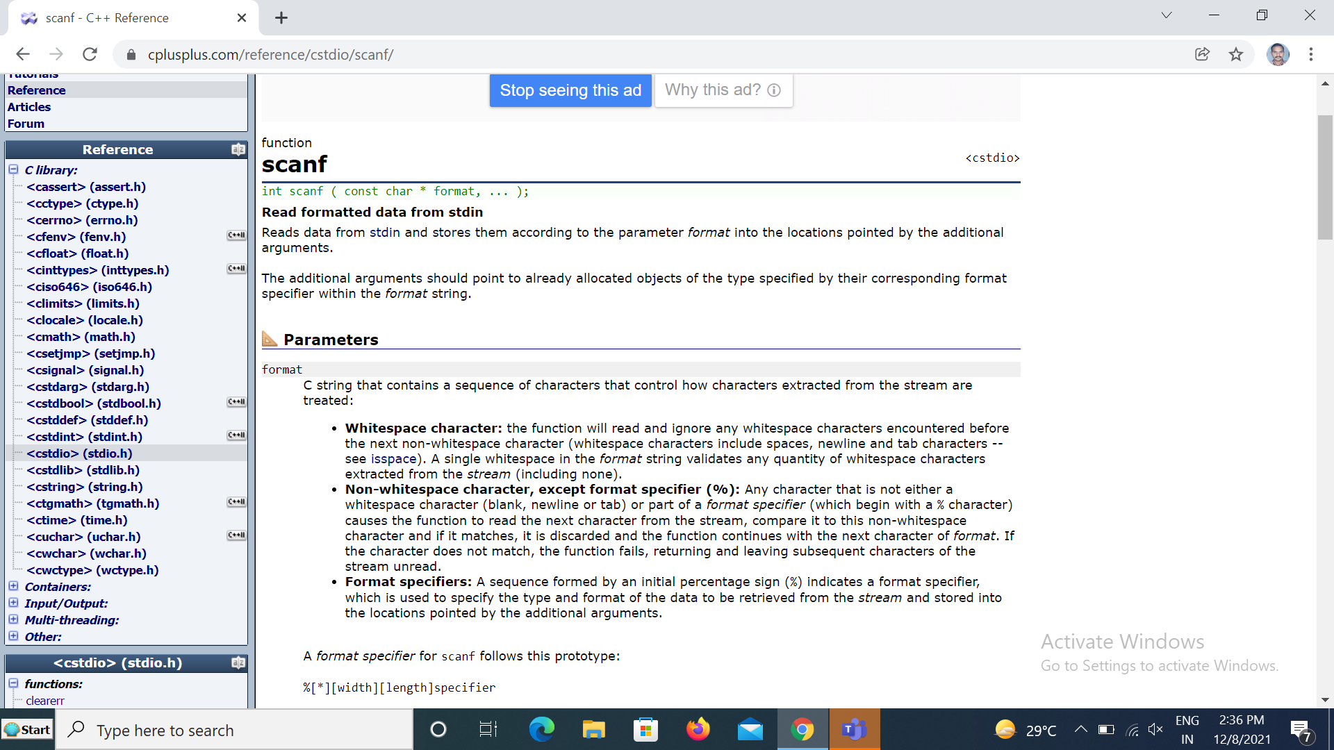
Return Value: On success, the function returns the number of items of the argument list successfully filled. This count can match the expected number of items or be less (even zero) due to a matching failure, a reading error, or the reach of the end-of-file. If a reading error happens or the end-of-file is reached while reading,EOF is returned.

Slide 26
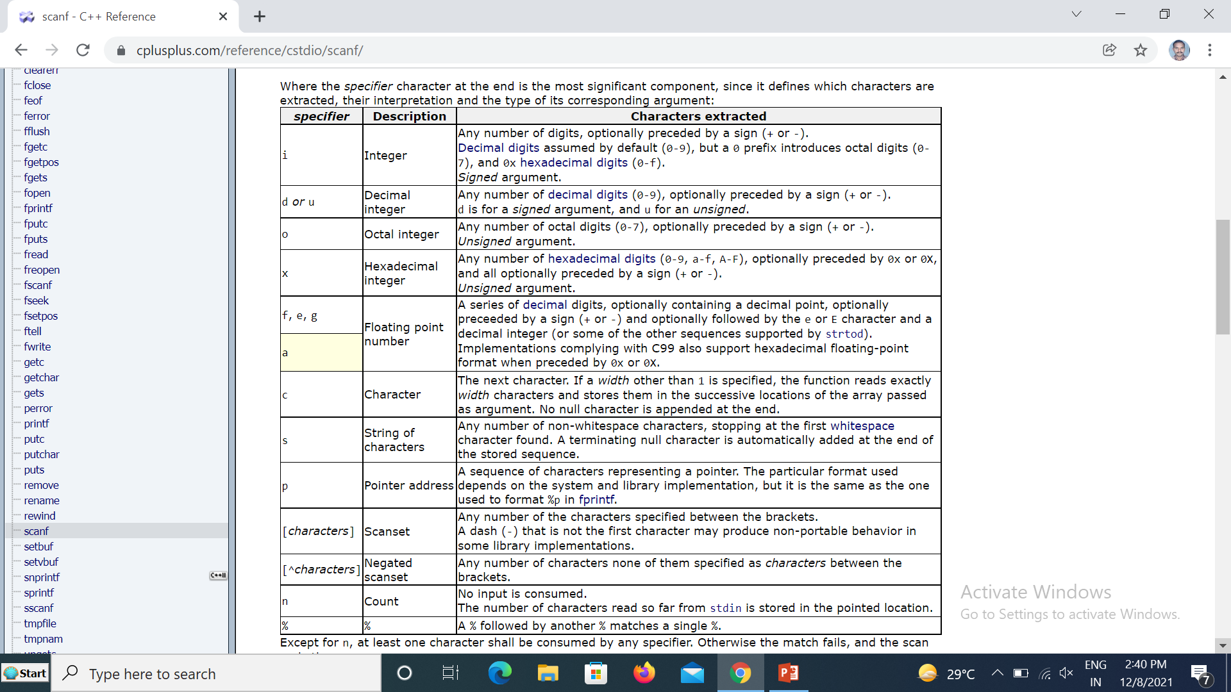

Slide 27
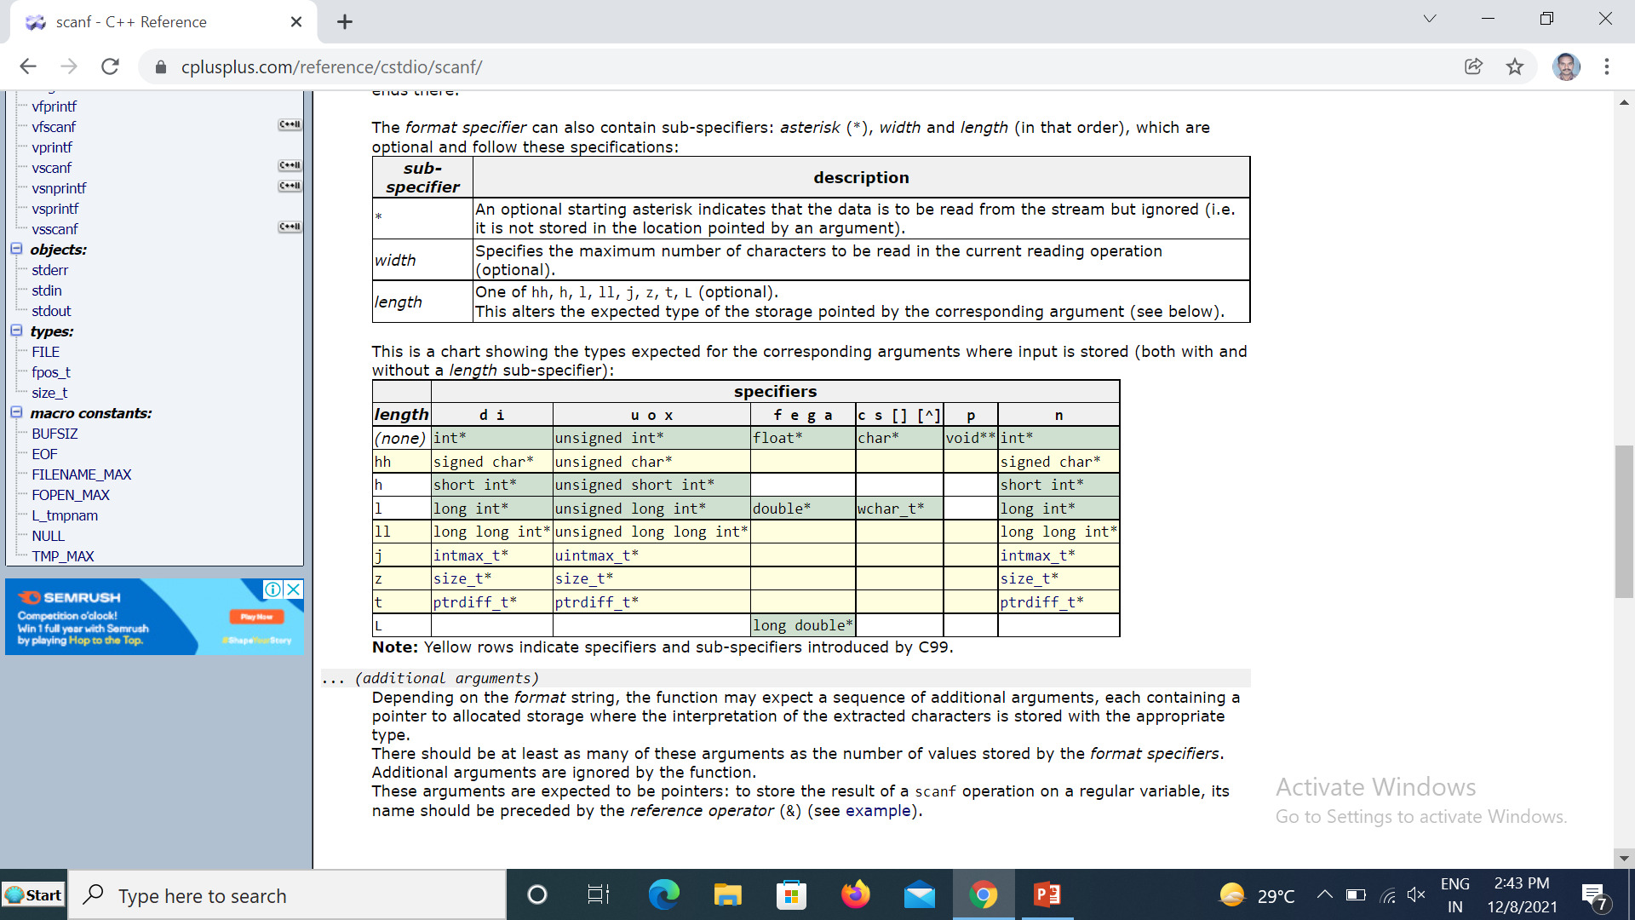

Slide 28
function
<cstdio>
printf
int printf ( const char * format, ... );
Print formatted data to stdout
Writes the C string pointed by format to the standard output (stdout).
If format includes format specifiers (subsequences beginning with %), the additional arguments following format are formatted and inserted in the resulting string replacing their respective specifiers.
Parameters
format
  C string that contains the text to be written to stdout.
  It can optionally contain embedded format specifiers that are replaced by the values specified in subsequent additional arguments and formatted as requested.
  A format specifier follows this prototype: [see compatibility note below]
  %[flags][width][.precision][length]specifier
Return Value
On success, the total number of characters written is returned.
If a writing error occurs, the error indicator (ferror) is set and a negative number is returned.
If a multibyte character encoding error occurs while writing wide characters, errno is set to EILSEQ and a negative number is returned.

Slide 29
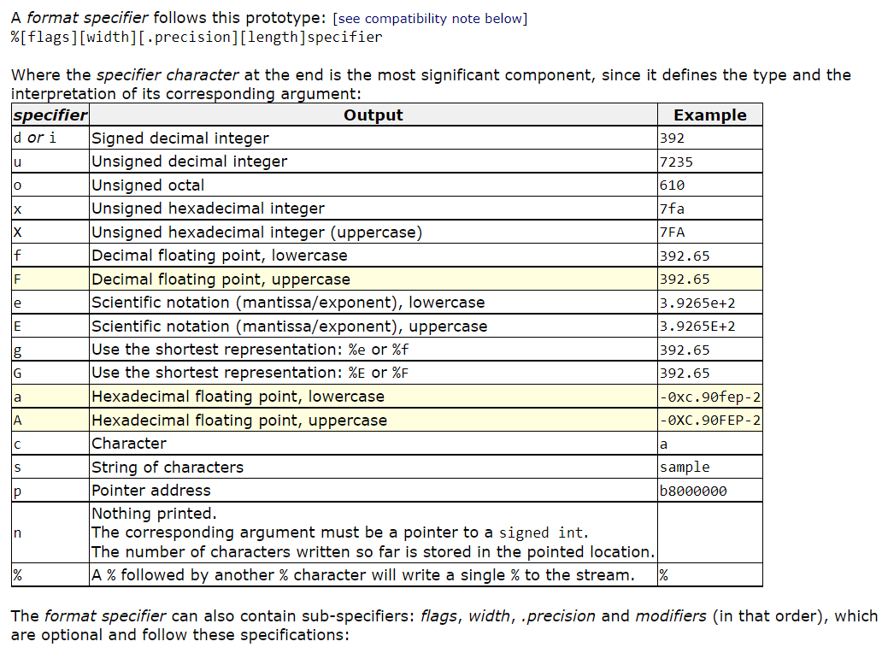

Slide 30
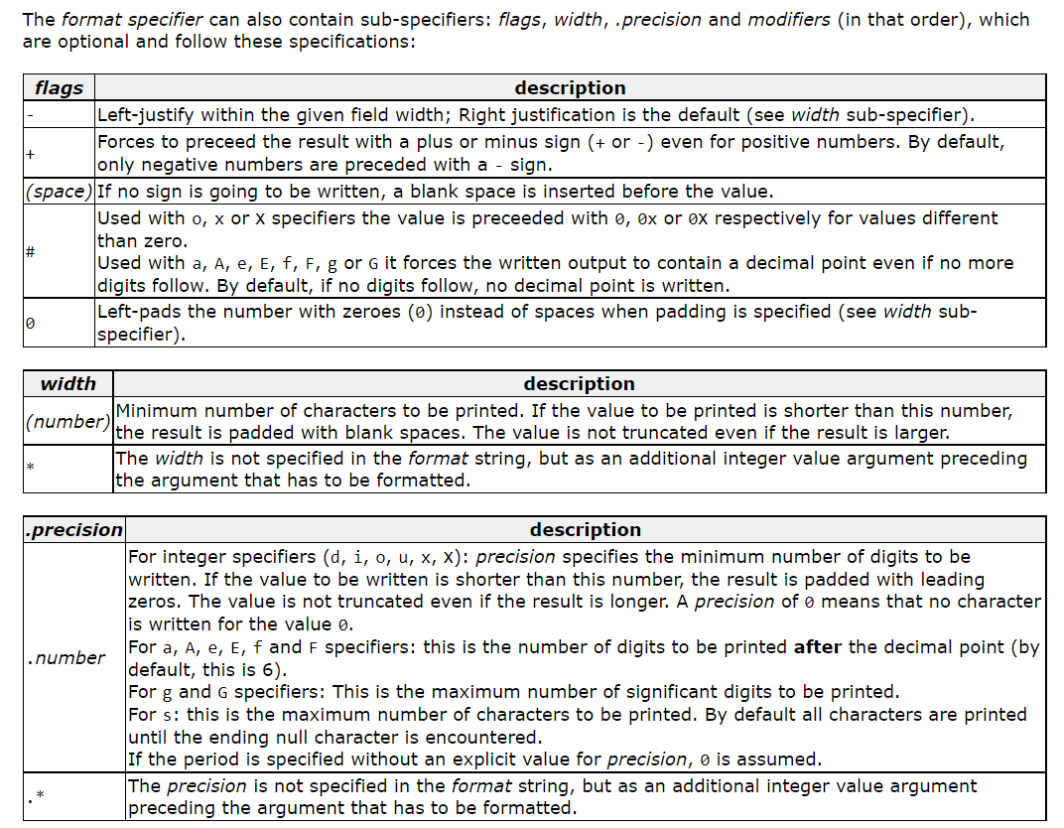

Slide 31
The length sub-specifier modifies the length of the data type.
This is a chart showing the types used to interpret the corresponding arguments with
and without length specifier (if a different type is used, the proper type promotion or conversion is performed, if allowed):
 | specifiers
length | d i | u o x X | f F e E g G a A | c | s | p | n
(none) | int | unsigned int | double | int | char* | void* | int*
hh | signed char | unsigned char |  |  |  |  | signed char*
h | short int | unsigned short int |  |  |  |  | short int*
l | long int | unsigned long int |  | wint_t | wchar_t* |  | long int*
ll | long long int | unsigned long long int |  |  |  |  | long long int*
j | intmax_t | uintmax_t |  |  |  |  | intmax_t*
z | size_t | size_t |  |  |  |  | size_t*
t | ptrdiff_t | ptrdiff_t |  |  |  |  | ptrdiff_t*
L |  |  | long double

Slide 32
scanf function | Printf function
Formatted input function | Formatted output function
Deals with ‘stdin’ file | Deals with “stdout’ file
Second arguments onwards address | Second arguments onwards values
It returns an integer to represent the no. of values read and stored at specified locations | It returns an integer to represent the no. of character displayed .
It returns EOF for its failure | It returns EOF for its failure
Non-White space Characters in the Control string are expected at the input | Non-White space Characters in the Control string are printed at the output
No Such facility | Flags are used in the control string
Scan set facility is available [ allowable Characters ] and [^ prevented Characters] | No such Facility
‘* ‘ at the width place skip that value | ‘*.*’ is used to specify the runtime specification
GET, CONVERT and STORE the values | GET, CONVERT AND DISPLAY the values.
Differences

Slide 33
Similarities between scanf() and printf() functions
Both are declared in stdio.h header file
Both are functions with variable no. of arguments(Variadic functions)
Both performed formatted operations
Both are Control string controlled functions
Both returns ‘EOF’ on fail to complete the operation
Scanf function failed due to
  Control string is Exhausted.
  End of File is encounter.
  Scan set character violations
Printf function failed due to
  Control string is Exhausted
  End of File is encounter
  Format specifier format
  % flags width prcison size modifier Conversion character
  E.g.: %- 10.3 l d

Slide 34
1 What is the output of this program? if input a is 1 and b is 2
#include <stdio.h>
int main()
{
int a, b;
printf("%d", scanf("%d %d",&a,&b));
return 0;
}
A. 1
B. 2
C. runtime error
D. compile time error
View Answer
Ans : B
Explanation: In C, scanf returns the number of inputs it has successfully read.

Slide 35
2. What is the output of this program?
#include <stdio.h>
int main()
{
int i;
i = printf("letsfindcourse");
i = printf("%d ", i);
printf("%d ", i);
return 0;
}
A. letsfindcourse 15 3
B. letsfindcourse 14 2
C. letsfindcourse 14 3
D. Compilation Error
View Answer
Ans : C
Explanation: In C, printf() returns the number of characters successfully written on the output. Here letsfindcourse contain 14 character therefore i = 14 and then i is printed now again value of printf is assign but this time it print 3 since it contain 3 character %,d and space.

Slide 36
3. Output of this statment is :
printf ( "%d" , printf ( "hello" ) );
A. Syntex Error
B. hello5
C. gives garbage value
D. print hello and terminates
View Answer
Ans : B
Explanation: Firstly inner printf executes and will print hello now this return the number of character printed that is 5 and this will be printed by outer printf . Hence output is hello5
4. What is the output of this program?
#include <stdio.h>
# define scanf "%s Find best course "
main() {
printf(scanf, scanf);
return 0;
}
A. % Find best course %sFind best course
B. %s Find best course %s Find best course
C. Invalid Syntex
D. Run time error
View Answer
Ans : A
Explanation: printf statement will become printf("%s Find best course ", "%s Find best course ");

Slide 37
5. Which statement is true about the given code ?
#include <stdio.h>
int main() {
printf("%d", main);
return 0; }
A. Goes in infinite loop B. Gives Address of function main.
C. Gives garbage value D. Compilation Error
View Answer
Ans : B
Explanation: Name of the function is actually a pointer variable to the function and prints the address of the function.
6. What is the output of this program?
#include <stdio.h>
int main() {
int i;
i = 1, 2, 3;
printf("%d", i);
return 0; }
A. 1 B. 2 C. 3 D. Invalid Syntax
View Answer
Ans : A
Explanation: Associativity of comma operator is from left to right, but = operator has higher precedence than comma operator.Therefore the statement i = 1, 2, 3 is treated as i = 1 .

Slide 38
7. Point out the error in the program?
#include<stdio.h>
int main()
{
char ch;
int i;
scanf("%c", &i);
scanf("%d", &ch);
printf("%c %d", ch, i);
return 0;
}
A. Error: suspicious char to in conversion in scanf()
B. Error: we may not get input for second scanf() statement
C. No error
D. None of above
Answer: Option B

Slide 39
8. Find the output of the given C program.
#include<stdio.h>
int main()
{
printf("%d Hello %d");
return 0;
}
a) None of these
b) Garbage_value Hello Garbage_value
c) 1 Hello 1
d) 0 Hello 0
View Answer
Answer:- b) Garbage_value Hello Garbage_value
8. Find the output of the given C program.
#include<stdio.h>
int main()
{
printf("%d", 1.9);
return 0;
}
a) garbage value
b) 1.9
c) 1
d) None of these
View Answer
Answer:- a) garbage value
float to int conversion can’t perform directly.

Slide 40
9. Find the output of the given C program.
#include<stdio.h>
int main()
{
printf(“Good", “Morning);
return 0;
}
a) Compile time Error
b) Good
c) Good Morning
d) Run Time Error
10.
#include<stdio.h>
int main()
{
int x;
x= printf(“HI\n”);
printf(“%d”,printf(“Hello\n”),x);
return 0;
}
10. Find the output of the following C program
#include<stdio.h>
int main () {
int i ;
scanf(“%d”,printf(“%d\n”,scanf(“%d”,&i)));
return 0;
}

